Slide 1

AI-Augmented Red Teaming
Sean Wong
2025/08/05

Slide 2

AI Red-Team Landscape
Recon & Intel Boost
Attack Path Modeling
Exercise Telemetry
Safe Infrastructure & Docs
Purple-Team & Ethics

Slide 3

Hands-On Triage
Adoption Playbook

Slide 4

01
AI Red-Team Landscape

Slide 5

AI Already Inside Red-Team Workflows
AI in Reconnaissance
AI in Attack Path Modeling
AI in Reporting
AI tools like Recorded Future and Maltego AI summarize OSINT data, highlighting potential attack surfaces and misconfigurations, speeding up the initial recon phase for red teams.
Platforms such as MITRE Caldera and AttackIQ use AI to map likely kill chains and suggest adversary TTPs aligned with MITRE ATT&CK, aiding in realistic scenario planning.
AI-assisted tools like Cortex XSOAR generate draft reports from logs and notes, summarizing attack paths and findings, significantly reducing the time spent on documentation.

Slide 6

Human-AI Division of Labor
AI Automation
Human Expertise
AI excels at automating repetitive tasks such as log analysis, data summarization, and report generation, freeing up red-teamers to focus on strategic planning and ethical considerations.
Red-teamers handle sensitive operational tasks requiring human skill, judgment, and authorization, ensuring that AI-driven activities remain ethical and controlled.

Slide 7
02
Recon & Intel Boost

Slide 8

AI Distills Recon Noise into Insight
AI tools like Recorded Future distill vast amounts of OSINT data into actionable insights, helping red teams quickly identify potential attack surfaces.
Maltego AI integrates with existing recon tools to map technologies used by target networks, providing a clear picture of the attack landscape.
AI algorithms detect patterns in recon output, flagging anomalies and potential vulnerabilities that might be missed by manual analysis.
AI helps prioritize areas for manual testing by highlighting high-probability targets, ensuring efficient use of red-team resources.
OSINT Summarization
Asset Mapping
Pattern Detection
Prioritization

Slide 9

Prioritize Targets Without Bias
Bias-Free Target Selection
AI-driven clustering algorithms rank public findings by risk and relevance, ensuring red teams focus on high-value targets without human bias, optimizing the effectiveness of their efforts.

Slide 10
03
Attack Path Modeling

Slide 11

Topology-Based Modeling
AI platforms like XM Cyber analyze network topology to map likely kill chains, identifying choke points and privilege boundaries that red teams can exploit.
MITRE ATT&CK Alignment
AI Plots Likely Kill Chains
AI suggests adversary TTPs mapped to MITRE ATT&CK, providing red teams with a structured framework for realistic and compliant adversary emulation.

Slide 12

Scenario Sandbox Before Click
Time-Efficient Planning
AI-driven scenario sandboxes enable red teams to quickly iterate and refine their plans, saving time and resources while maintaining operational safety.
Pre-Engagement Planning
Red teams can use AI to pre-plan rollback steps and select optimal entry vectors, ensuring safe and controlled engagements without touching production systems.
Simulated Attack Graphs
AI generates simulated attack graphs to forecast detection probability and control bypass difficulty, allowing red teams to refine their strategies before engaging.

Slide 13
04
Exercise Telemetry

Slide 14
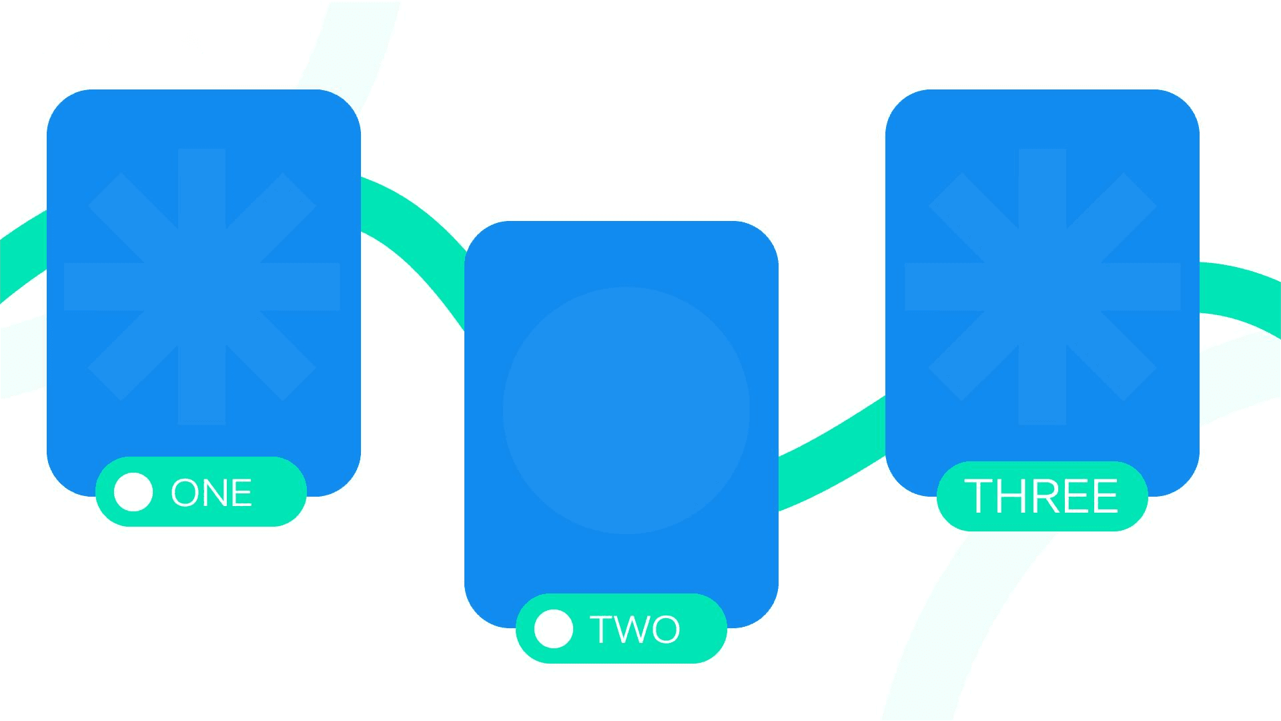
AI Correlates Red Actions to Blue Alerts
Event Clustering
Real-Time Analysis
AI tools like Elastic Security ML cluster millions of events triggered during drills, revealing uncorrelated logs and silent EDR rules that manual reviews might miss.
AI-driven analysis provides real-time feedback during exercises, enabling red and blue teams to quickly identify and address gaps in their strategies.
Detection Gap Identification
AI identifies detection gaps by correlating red-team actions to blue-team alerts, providing actionable insights for improving defensive capabilities.

Slide 15

Automated Coverage Heatmaps
AI generates ATT&CK coverage heatmaps, visualizing detection gaps and guiding purple-team tuning efforts, ensuring continuous improvement.
Detection Gap Heatmap in Minutes
Efficient Post-Mortem Analysis
AI-driven heatmaps provide a clear overview of detection gaps, enabling efficient post-mortem analysis and facilitating continuous improvement in defensive strategies.

Slide 16
05
Safe Infrastructure & Docs

Slide 17

Safe Simulation Artifacts
AI recommends benign simulation artifacts, ensuring red-team infrastructure remains compliant and secure, preventing unintended exposure.
Synthetic Payloads & Labs on Demand
Isolated Cloud Labs
AI spins up isolated cloud labs with pre-hardened IAM roles, providing a safe environment for red-team exercises and reducing operational risk.

Slide 18

Draft Reports While You Sleep
Automated Report Generation
AI tools like Cortex XSOAR convert raw logs and notes into structured draft reports, significantly reducing the time spent on documentation.
Executive Summaries
Consistent Deliverables
AI translates technical actions into executive summaries, making it easier for non-technical stakeholders to understand the findings and recommendations.
AI ensures consistent technical depth and clarity in reports, maintaining high standards across different engagements and red-team members.

Slide 19
06
Purple-Team & Ethics

Slide 20

AI Suggests Next Purple Test
Continuous Validation
AI analyzes previous red actions and blue detentions to propose fresh detection test cases, ensuring continuous validation and improvement of defensive capabilities.
Efficient Purple-Team Iterations
AI-driven suggestions enable efficient purple-team iterations, preventing repetitive engagements and ensuring continuous learning and improvement.

Slide 21

Governance Guardrails Built-In
AI policy-alignment engines compare planned tactics against rules of engagement, flagging potential scope creep and ensuring compliance.
AI generates pre-authorization checklists, embedding compliance into planning and reducing the risk of unauthorized activities.
AI helps maintain ethical standards by highlighting potential scope violations and ensuring red-team activities remain safe and authorized.
Policy Alignment
Pre-Authorization Checklists
Ethical Red Teaming

Slide 22
07
Hands-On Triage

Slide 23

Task Scoring Matrix for AI Readiness
AI Readiness Assessment
Teams list recurring red-team tasks and score them based on repetition, data volume, documentation intensity, and scenario planning needs to identify suitable AI candidates.

Slide 24

Recon Data Sprint Simulation
Sample Data Analysis
Hands-On Experience
Efficiency Comparison
Using a sample dataset, teams apply AI clustering to surface top attack surfaces, craft emulation hypotheses, and estimate time savings.
Participants gain hands-on experience with AI tools, learning how to quickly distill recon data and prioritize targets for manual testing.
Compare AI-driven analysis with manual methods to highlight the efficiency gains and potential benefits of integrating AI into red-team workflows.

Slide 25

AI-Generated Drafts
Minimal Edits Needed
Participants feed raw logs and notes into an AI summarizer, comparing machine-generated drafts with human-written reports for clarity and accuracy.
Teams identify minimal edits required to finalize AI-generated reports, demonstrating the potential for significant time savings in documentation.
Report-Write Relay Race

Slide 26
08
Adoption Playbook

Slide 27

One-Page AI Red-Team Cheat Sheet
Quick Reference
Avoid Tool Sprawl
Maintain Compliance
A one-page cheat sheet maps every red-team phase to vetted AI tools, risk notes, and human checkpoints, providing a quick reference for managers.
The cheat sheet helps avoid tool sprawl and unauthorized utilities by providing a centralized resource for AI integration.
The cheat sheet ensures compliance with organizational policies by highlighting ethical considerations and authorization requirements.

Slide 28

Ethical & Privacy Checklist
Data Encryption
Align with Policies
Confirm data encryption, bias audits, scope limitation, audit trails, and dual-use safeguards before deploying any AI tool.
Align AI choices with organizational ethics policies to protect client data and maintain stakeholder trust.

Slide 29

Pilot-to-Scale Roadmap
Start with Low-Risk Tasks
Run a Pilot Program
Expand Horizontally
Embed Continuous Training
Begin with low-risk reporting tasks to establish a baseline and measure the impact of AI integration.
Run a four-week pilot with volunteer testers to gather feedback and refine AI prompts and processes.
Expand AI integration horizontally across recon, simulation, and analytics, ensuring continuous improvement and alignment with red-team goals.
Embed continuous training to ensure red-team members are proficient with AI tools and can effectively leverage them in their workflows.

Slide 30

2025/08/05
Sean Wong

